Slide 1
MTN-025/HOPE
Decliner Population Procedures

Slide 2
Who are the Decliner Population?
Former ASPIRE participants who decline or express no interest in joining the main HOPE study
These participants will be offered participation as part of the Decliner Population subset

Slide 3
Who are the Decliner Population?
Being found ineligible for HOPE enrollment (screen failure) does not equate to declining participation in the study. Only participants who actively decline study participation (i.e. express disinterest in enrollment) should be considered for decliner group enrollment.
Notes:
For example, if a participant was ineligible due to positive HIV or pregnancy testing, they should not be considered for decliner population enrollment.

Slide 4
Participant Accrual
Participants may be identified at the point of first recruitment contact (e.g. phone contact); therefore it is important that staff are prepared to offer education on the Decliner Population at that time.

Slide 5
Participant decided to join the Decliner Population, what’s next?
Schedule study visit
If participant is at the clinic → administer the ICF. Visit procedures can be conducted on the same day.
If participant is not at the clinic → conduct screening and enrollment procedures off site or schedule visit at the clinic.
The study visit can be conducted at a single visit or multiple visits.
Notes:
The number of visits will depend on participant’s and site schedule and time required to complete all procedures.

Slide 6
Off-Site Considerations
Visit(s) can be conducted at either the participant’s home or designated neutral location
Staff must ensure that participant confidentiality is maintained and study records will be safely maintained
To minimize risk of social harm, before you conduct the visit, discuss with participants:
If they have disclosed participation to family, neighbors, or others that may learn of these visits
Discuss with participants how staff will identify themselves

Slide 7
Visit Checklist
Notes:
We will next go through the procedures outlined in the decliner visit checklist here.

Slide 8
Informed Consent Process
The process is the same as for the HOPE informed consent:
Informed consent must be administered prior to completing any decliner group procedures
Notes:
The informed consent administration should follow site-specific SOP and guidelines provided in Section 5 of the SSP manual.
More on the HOPE informed consent process is coming in a later presentation.

Slide 9
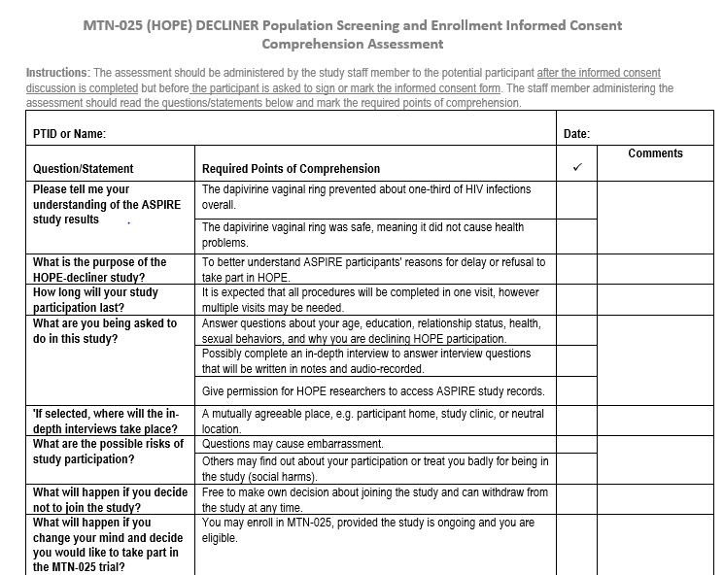
Prior to signing the ICF, participants should fully understand study information - comprehension assessment will be used for this purpose

Slide 10
Informed Consent Process
IC process must be documented per site and DAIDS SOP
Notes:
Documentation of informed consent will be covered in the informed consent training.

Slide 11
PTID Assignment
PTID assignment for the Decliner Population will follow the same guidance as HOPE, and both decliners and full-study participants will be listed in the same log
Notes:
This is the same process as for the full HOPE study population and will be covered in more detail in the screening presentation

Slide 12
Assessing Eligibility
Inclusion:
Able and willing to provide informed consent
Participated in MTN-020 (ASPIRE)
Declines participation in the main HOPE study
Able and willing to perform the Decliner Population study procedures
Exclusion:
Has any other condition that, in the opinion of the IoR/designee, would preclude informed consent, make study participation unsafe, complicate interpretation of study outcome data, or otherwise interfere with achieving study objectives.

Slide 13
Behavioral Eligibility
Evaluated by administration of the Decliner Behavioral Eligibility Worksheet

Slide 14
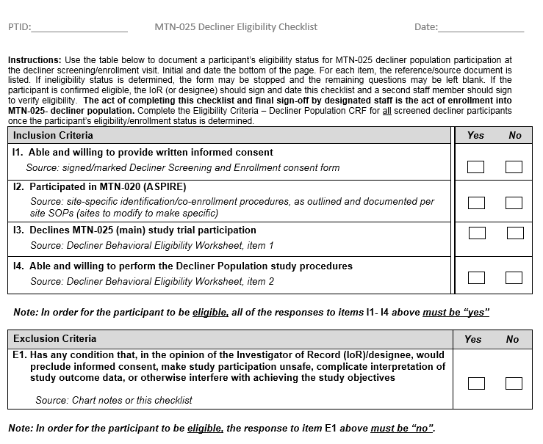
Eligibility Criteria Checklist
Once eligibility is assessed and participant is found eligible, the IoR or designee completes final sign-off on the Decliner Eligibility Checklist.

Slide 15
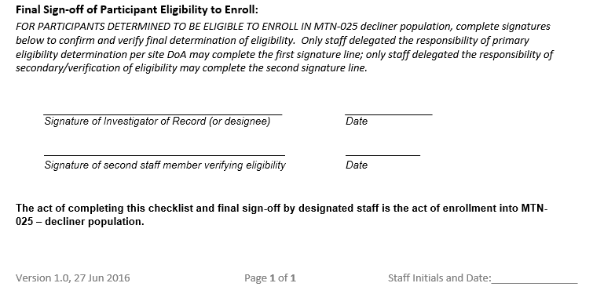
Definition of Enrollment
A second staff member will verify eligibility and also sign-off on the Decliner Eligibility Criteria Checklist. At this point the participant is considered enrolled in the decliner population subset.
Notes:
Additionally, the site IoR or designee will sign-off on the Eligibility Criteria – Decliner Population eCRF via an electronic signature to confirm participant eligibility within Medidata Rave.

Slide 16
Visit Procedures
After participant is enrolled, conduct the following procedures:
Collection of demographic data
Administration of behavioral assessment
If applicable, conduct of in-depth interview (at sites participating in the qualitative component and if the participant is selected for a decliner IDI)
Provide reimbursement
Notes:
As a reminder, it is expected that procedures involved with the HOPE Decliner Population will be completed in one visit; however, multiple visits may be scheduled to complete these procedures.

Slide 17
Required Documentation
Participant Files and Source Documentation:
Eligibility criteria documentation
Informed consent documentation
All contacts and attempted contacts
Procedures performed by study staff during the study
Case report forms (CRFs) applicable to decliners and other forms (e.g. Decliner Behavioral Eligibility Worksheet and Decliner Eligibility Checklist, Screening and Enrollment Logs)

Slide 18
Required Documentation
CRFs to be completed for all enrolled decliner participants:
Eligibility Criteria – Decliner Population
Enrollment – Decliner Population
Demographics
Baseline Behavior Assessment

Slide 19
Required Documentation
Referrals made as a result of information gathered during decliner visit procedures
If applicable (for sites participating in the qualitative component, and for those participants selected for a decliner IDI): interview transcripts, notes recorded on interview guides, separate sheets, and/or additional materials used for IDIs

Slide 20
Pop Quiz
Throughout the training, we will have several pop quizzes for you to participate in, individually. Keep a paper specifically for this, and we will provide answers after each quiz.
The team member with the most correct answers at the end of day 2 wins!
Notes:
You’ll get a limited amount of time to answer each of the pop quiz questions – we will keep score over the training, so hold on to your paper!

Slide 21
Decliner Pop Quiz
Get out your quiz paper!

Slide 22
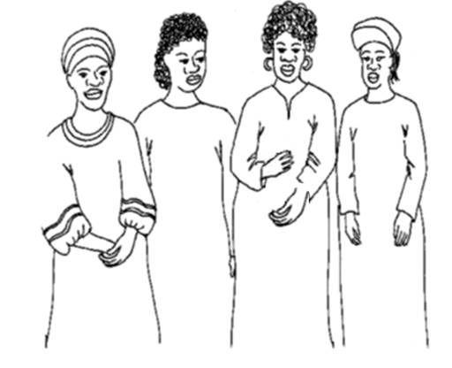
Decliner Pop Quiz
If a decliner does not want to come to the clinic, can her visit take place off-site?

Slide 23
Decliner Pop Quiz
At what point is a participant considered enrolled in the HOPE decliner population?

Slide 24
Decliner Pop Quiz
Do study staff need to complete behavioral assessments with HOPE decliners?

Slide 25
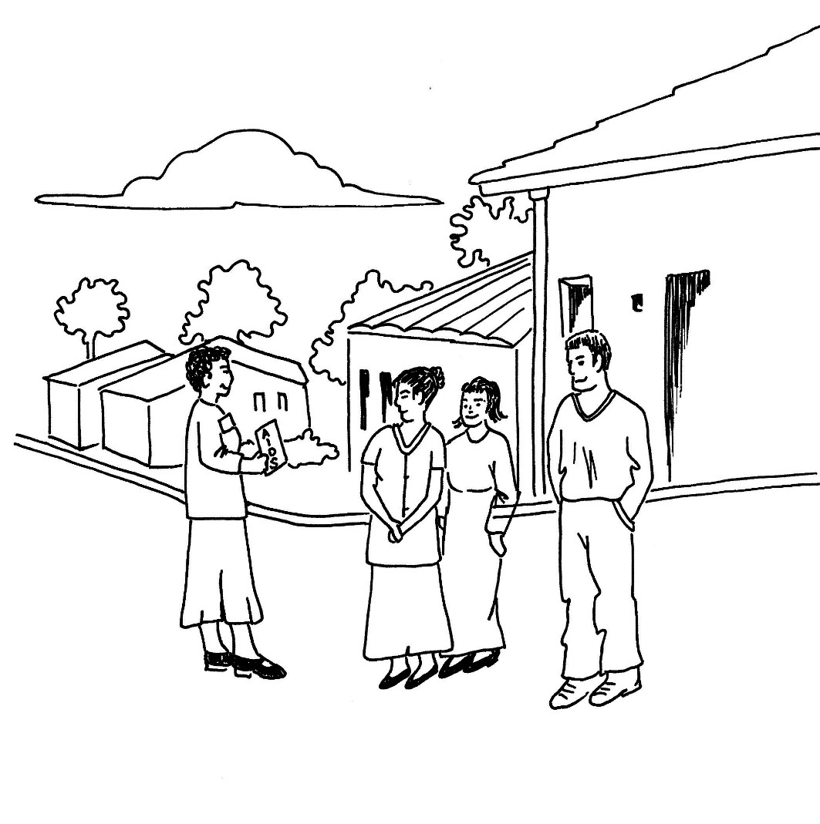
Decliner Pop Quiz
PTID assignment for decliners is the same as _____? (Fill in the blank!)

Slide 26
Decliner Pop Quiz
True or false? Decliner visit procedures must be completed in one visit.
Notes:
.

Slide 27
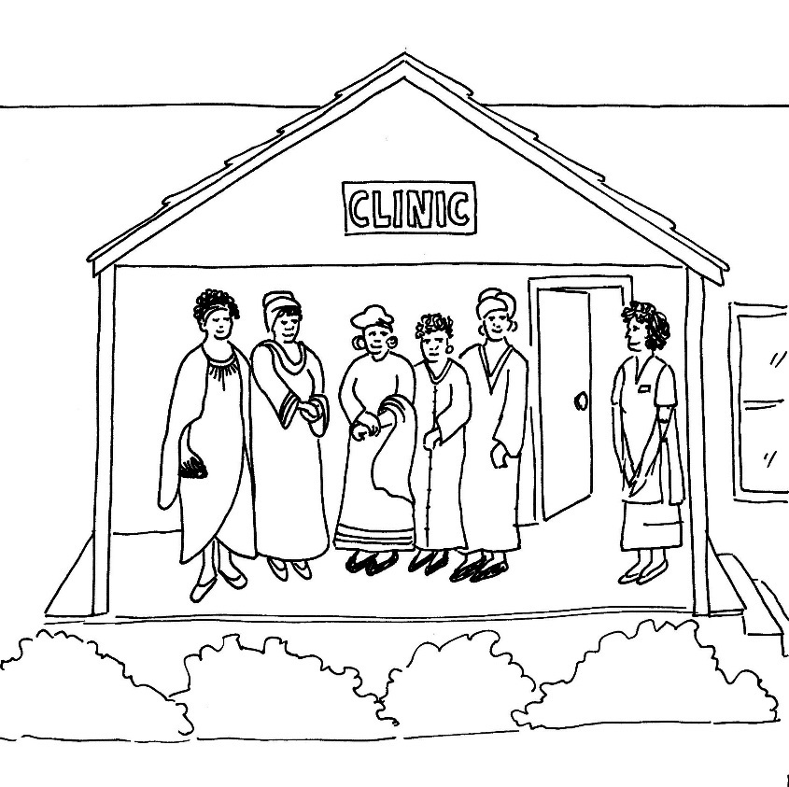
Decliner Pop Quiz
How did you do?
Yes – as long as she has consented to this according to site procedures.
After second sign-off on the eligibility checklist
Yes
HOPE full study participants
False!
Notes:
Any questions?

Slide 28
Screen Failures
For ineligible participants, the following documentation should be in place:
Completed Decliner Screening and Enrollment ICF
Reason(s) for ineligibility and date
Completed Eligibility Criteria – Decliner Population CRF, updated with screen failure reason(s) and submitted to SCHARP

Slide 29
Screen Failures (cont.)
Necessary referrals on file (as appropriate)
All documentation (e.g. source, chart notes) completed up until the time that ineligibility was determined
Indication of what visit procedures were conducted (on visit checklists)
Notes:
In addition, the Decliner Screening and Enrollment Log should be updated with date of discontinuation of screening and reason for screen failure (list item number as appropriate from the Decliner Eligibility Checklist).

Slide 30
Screening and Enrollment Log

Slide 31
What Are Your Questions about Decliner Population?

